Slide 1
Robotics Pick and Place Project
Presented by:
Team K-21
Ziad sherif
Mohannad Noaman
Mazen motaz
Ahmed gobran
Kirolos George
Mohamed Farid

Slide 2
Outline
DH convention
Sim scape simulations
Coppelia Sim simulations
hardware implementation
Implementations

Slide 3
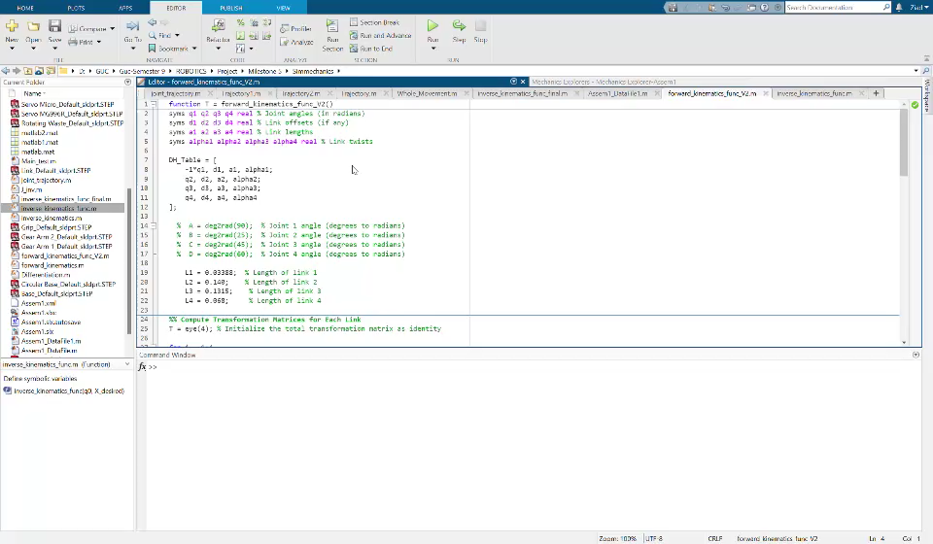
Motivation
DH-convention
⬤
Sim Scape simulation
Coppelia sim Simulation
Hardware Implementations
Implementations
DH-convention

Slide 4
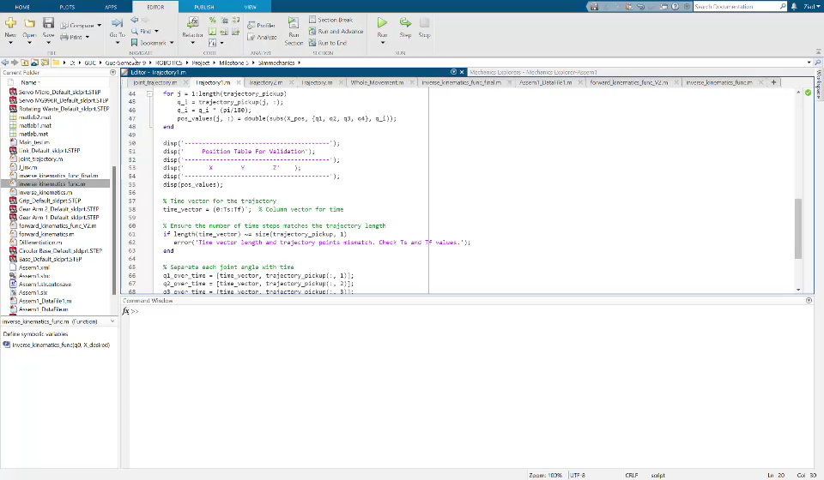
Motivation
DH-convention
Sim scape simulation
⬤
Coppelia sim Simulation
Hardware Implementations
Implementations
Sim Scape Simulation

Slide 5
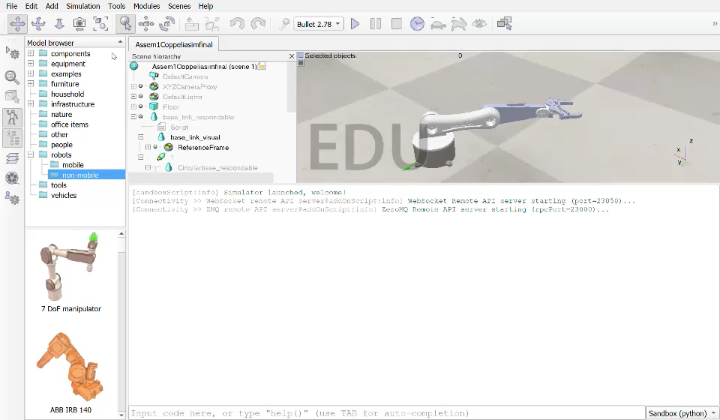
Motivation
DH-convention
Sim scape simulation
Coppelia sim simulation
⬤
Hardware implementation
Implemenattions
Coppelia sim simulation
Notes:
And then to talk about the another half of my bachelor this is a video that talk more about Digital twin . So here is the question that most of you are asking what is Digital Twin . Digital is like looking at yourself at mirror but as we know what you are seeing in mirror is not really meaning that you can not touch yourself for an example and this is the same idea of Digital twin you create a virtual copy of a reality or lets say physical model that has all of its characteristics and data you may need in that virtual copy . Moreover it is used in a lot of application like Manufacturing , automation , construction , utilities And healthcare

Slide 6
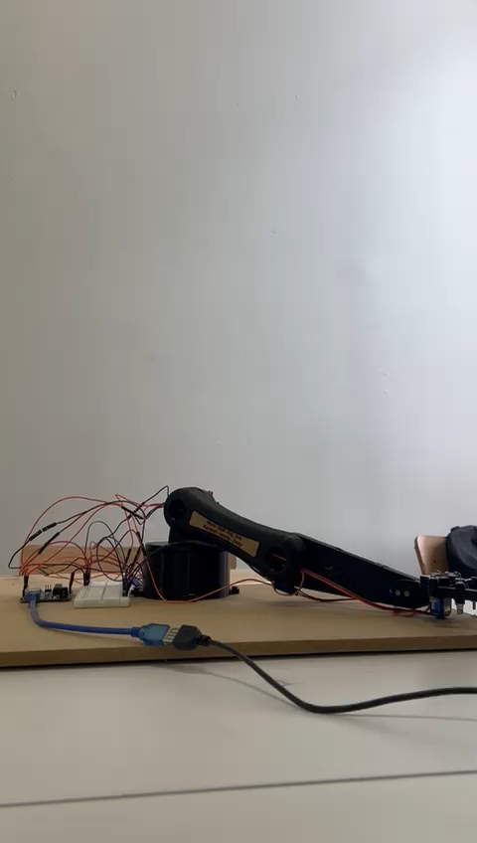
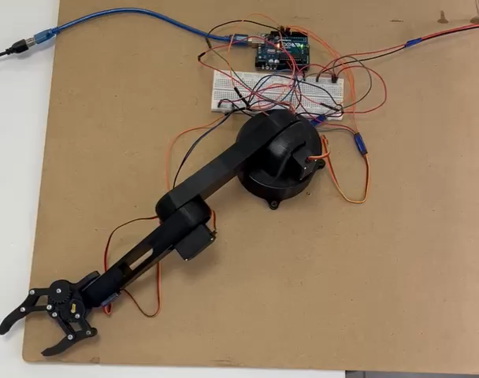
Motivation
DH-convention
Sim scape simulation
Coppelia sim simulation
Hardware implementation
⬤
Implementations
Hardware implementation

Slide 7
Motivation
DH-convention
Sim scape simulation
Coppelia sim simulation
Hardware implementation
Implementation
⬤
Implementation
DH convention (Kirollos George + Mohamed Farid)
Matlab Scripts (Ziad + Mohannad Noaman + Mazen Moataz)
ElectricalSimulations (Kirollos George)
Simscape simulations (Ziad Sherif + Ahmed Gobran + Mohannad Noaman)
CoppeliaSim simulations (Ziad Sherif + Mazen Moataz)
hardware implementation (Kirollos George + Ziad Sherif +Mohannad Noaman)

Slide 9


